Slide 1
Laterite Soil
Resources and Development

Slide 2
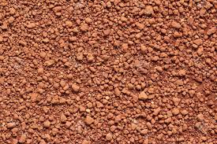
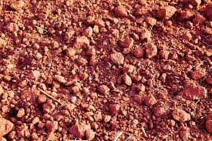
What is Laterite Soil ?
Lateritic soils are sometimes used as an iron ore and source of nickel, they are widely used as construction materials for houses,roads,dam embankment, landfills and flexible pavement foundations
And 4.30% total India’s Soil

Slide 3
What do You mean by the Name ‘Laterite’
Laterite has been derived from the Latin word ‘later’ which means brick.

Slide 4
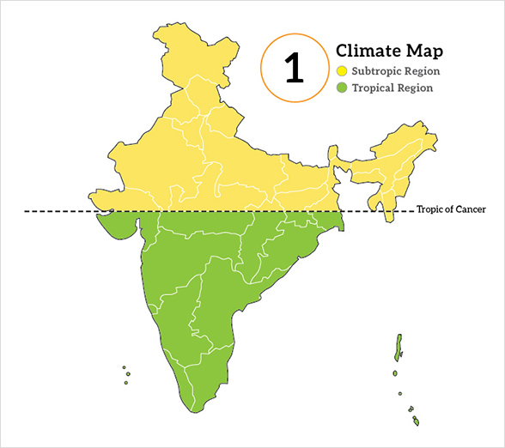
How laterite Soil is formed ?
The laterite soil develops under tropical and subtropical climate with alternate wet and dry season.
This soil is the result of intense leaching due to heavy rain
Leaching
leaching is the loss of water-soluble plant nutrients from the soil, due to rain and irrigation.

Slide 5
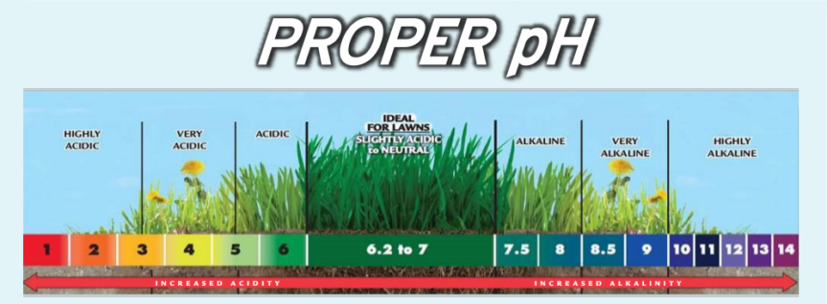
PH Level
Lateritic soils are mostly deep to very deep, acidic (pH<6.0), generally deficient in plant nutrients and occur mostly in southern states,

Slide 6
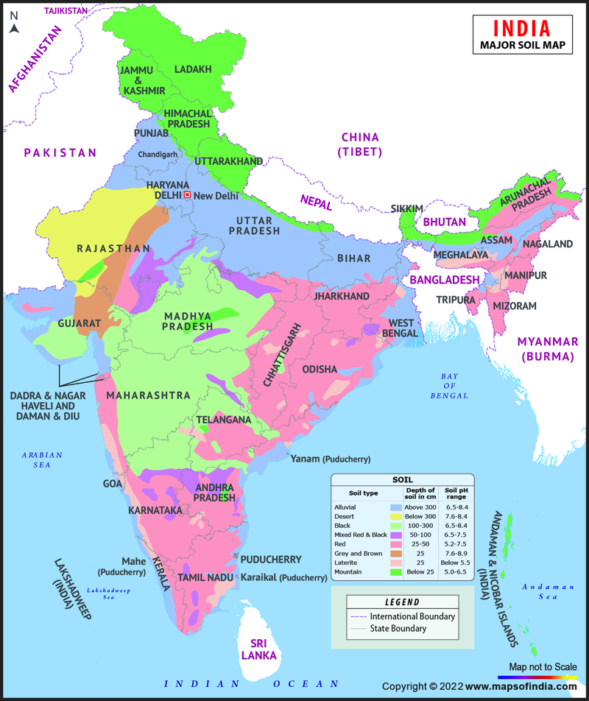
Location
Western Ghats region of Maharashtra,
Odisha, some parts of West Bengal and
North-east regions

Slide 7
Vegetation
Deciduous and evergreen forests, it is humus rich
Under sparse vegetation and in semi-arid environment, it is generally humus poor
Rich In
Deficient in
Iron
Aluminium
Nitrogen
Potash
Potassium
Lime
Humus

Slide 8
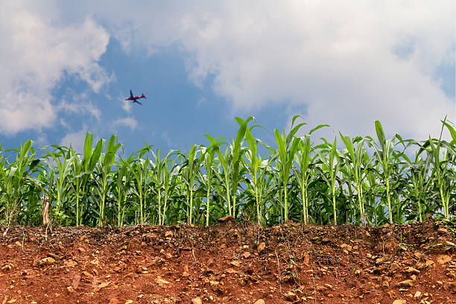
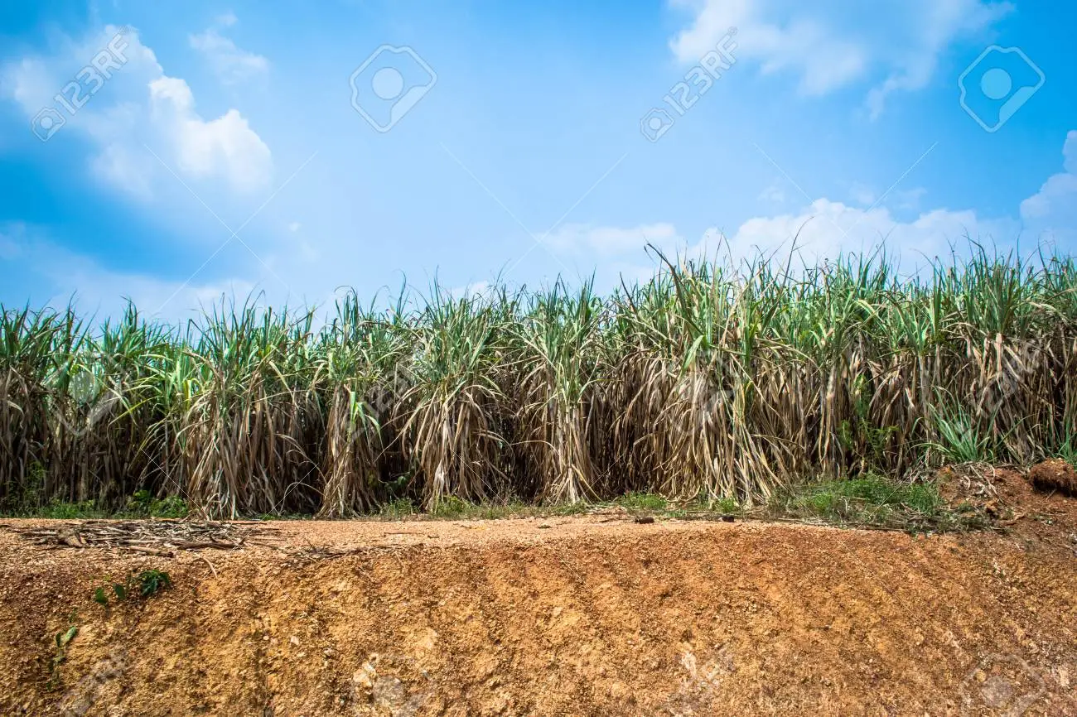
Used For Growing ?
They are prone to erosion and degradation due to their position on the landscape.
After adopting appropriate soil conservation techniques particularly in the hilly areas of Karnataka, Kerala and Tamil Nadu, this soil is very useful for growing tea and coffee. Red laterite soils in Tamil Nadu, Andhra Pradesh and Kerala are more suitable for crops like cashew nut.

